Slide 1

Comfort Centre Training
Level 1

Slide 2
Agenda
Introductions
Halifax Regional Municipality
Emergency Management
JEM Program
Comfort Centres
Situations
Supports & Resources

Slide 3


Introductions
  Name, pronouns
  Are you connected to any other organizations, agencies, community groups?
  Have you been to a Comfort Centre before?
Notes:
Opportunity for group interaction.
Go around the room for everyone to share:
Names
Connections to other organizations, agencies, community groups (if any)
Previous experience with Comfort Centres (if any)
Dog - Photo by Charles Deluvio on Unsplash
Open - Photo by Clay Banks on Unsplash

Slide 4
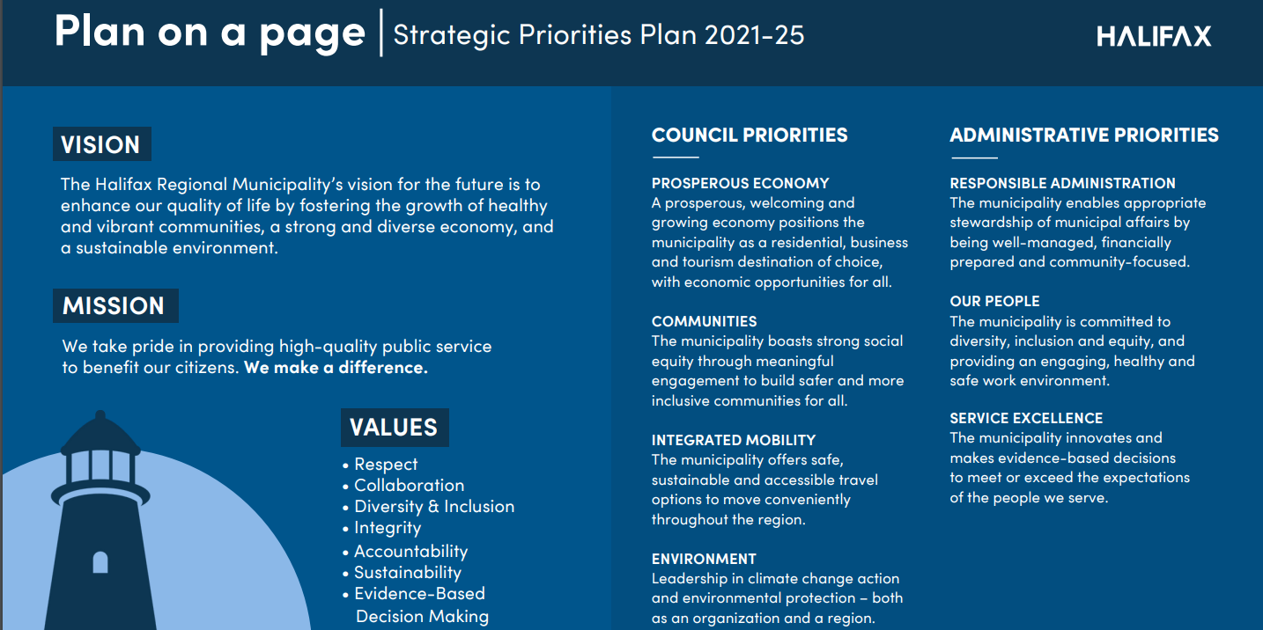
Halifax Regional Municipality
Policies, Procedures, Guidelines
“I understand that I must adhere to all of HRM policies, procedures, and operating guidelines.”
Notes:
When you volunteer with JEM, you are representing the HRM and are expected to adhere to all HRM policies, procedures, and operating guidelines.
A full list of HRM policies can be found at www.halifax.ca. You can also access the HRM Strategic Priorities Plan which outlines HRM’s 7 core values:
Respect
Collaboration
Diversity and Inclusion
Integrity
Accountability
Sustainability
Evidence-based decision making

Slide 5
Emergency Management
Preparedness
Mitigation
Response
Recovery
Municipal Emergency Plan:
https://cdn.halifax.ca/sites/default/files/documents/city-hall/regional-council/170801rc1433.pdf
Notes:
JEM volunteers are part of the Emergency Management department of HRM which may be referred to as the Emergency Management Office (EMO). To respond and recover effectively from potentially catastrophic events, the Halifax Regional Municipality has created a Municipal Emergency Plan which gives volunteers the authority to carry out certain duties. The roles and responsibilities of an EMO volunteer are defined in the Plan (may be accessed online) and we will review them in this training.
https://cdn.halifax.ca/sites/default/files/documents/city-hall/regional-council/170801rc1433.pdf
Looking at the framework of Emergency Management, JEM Volunteers support the all 4 phases through:
Preparedness – public education, training
Mitigation – public education, training
Response – Comfort Centre, Information Centre
Recovery – Comfort Centre, Information Centre
JEM volunteers are an integral part of the humanitarian response however, they are not involved in the emergency response. Volunteers deal with impacts to people, not impacts to infrastructure/environment.

Slide 6



Joint Emergency Management Teams (JEM)
Comfort Centre Management
  Set up & Operation
Community Status Updates
  Facility Profiles
  Public Education
    HRVA (Hazard Risk Vulnerability Assessment)
    VVPR (Voluntary Vulnerable Persons Registry)
    FireSmart
Notes:
Joint Emergency Management (JEM) is an HRM-led program with more than 200 dedicated volunteers who are grouped by region into what we call JEM teams.
JEM teams receive training and support from Emergency Management to be able to do three main functions:
Provide community-based updates to EMO before, during and after an emergency – eyes, ears, and boots on the ground across HRM.
Educate the public on community safety programs through presentations and at events.
Main priority is to set up and operate Comfort Centres during an emergency.
Examples of past community updates:
Facility Profiles – collecting data on HRM and community-owned facilities for EMO mapping system. Helps EMO select most appropriate Comfort Centre location.
Cataloging Bridges – No pictures of bridges in HRM files. Only know through local knowledge or physically checking on the bridge about the current state of repair, usability, existence. Some bridges are listed in files but don’t actually exist.
Boat ramp locations – Where are these and can they be used for rescue?
Examples of Public Education:
72 Hour Preparedness
Hazard Risk Vulnerability Assessment – (HRVA) HRM wide project to identify, map and develop plans to mitigate. JEM involved at public meetings, education, etc.
FireSmart – Halifax Fire starting up the Fire Smart Canada program in HRM. It is a process in which homeowners can have their properties evaluated for wildfire risk. JEM involvement will be assisting in make the public aware of the program.
hfxALERT – following slides

Slide 7
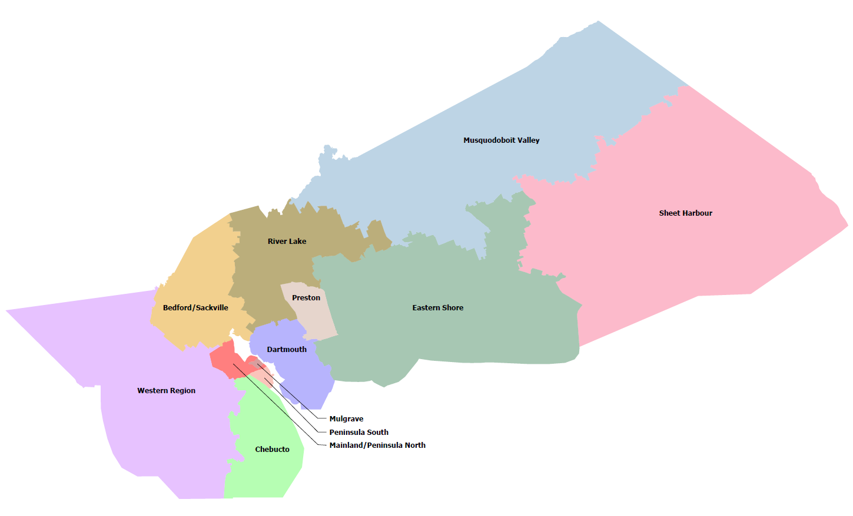
JEM Boundaries
Notes:
JEMs were first called Local Disaster Planning Committees
First team formed in the Sheet Harbour area in the year 2000
As a result of the Swissair crash of 1998, volunteers came together to prepare to help their community in times of crisis and emergency
The name Joint Emergency Management (JEM) was selected by the volunteers in 2005
JEM is unique to HRM
Developed by volunteers
By the community and for the community
Neighbours helping Neighbours
Currently there are 6 active JEM teams. Our goal is to have 12 teams throughout the Municipality. Emergency Management is working on a recruitment and retention strategy for growth.
Active Teams:
Western Region – Timberlea, Tantallon, St. Marg. Bay, Peggy’s Cove, Prospect areas
Eastern Shore – Porter’s Lake, Mineville, Musquodoboit Harbour, Chezzetcook, Lawrencetown, Clam Harbour, Lake Echo
Mainland North – Fairview, Fairmont, Larry Uteck
River Lake – Fall River, Grand Lake, Waverley
Sackville/Bedford – Bedford, Sackville, Beaverbank
Musquodoboit Valley
Teams Under Development:
Dartmouth
Mulgrave
Preston
Chebucto
Peninsula South
Sheet Harbour

Slide 8

Mass Notification System
HRM owned and operated
Mass notification system for the Municipality, keeping residents informed about emergencies and operations updates
Must sign up to get messages
https://www.halifax.ca/fire-police/fire/emergency-management/hfxalert
Notes:
EMO provides support to public alerting via two systems: Alert Ready and hfxALERT.
hfxALERT is the Municipality’s mass notification system which sends urgent and non-urgent messages from Halifax Regional Police, Halifax Fire, Emergency Management Division, and municipal winter parking ban notices. It is a subscription based system and messages can be sent via Voice, Email and Text, depending on what contact information is provided upon registration.
It is important to note that this is NOT the same as the NS Provincial alerting system (Alert Ready) which will be covered in the next slide.
As a JEM volunteer, you will be registered for hfxALERT to receive messages about JEM volunteer work only, such as meeting notices and emergency activations.
If you would like to receive additional alerts, registration may be done through the website: https://www.halifax.ca/fire-police/fire/emergency-management/hfxalert

Slide 9

Alert Ready
Provincially Operated
Issues emergency alerts via Television, Radio, Cell Phones and Wireless Devices
Public awareness tests are held twice per-year
Used to reach all of HRM
Notes:
https://en.wikipedia.org/wiki/Alert_Ready
Alert Ready is Canada’s emergency alerting system. Alert Ready delivers critical and potentially life-saving alerts to Canadians through television, radio and LTE-connected and compatible wireless devices. Alert Ready can send intrusive alerts to be broadcasted immediately because of imminent threat to life. Although HRM does not issue alerts through this method, we may send a request to the province, if it is warranted.

Slide 10


Comfort Centres
Comfort Centres are temporary daytime accommodations that provide refreshments, device charging, and up-to-date information, when residents are impacted by prolonged power outages, extreme temperatures or other significant events.
Notes:
A Comfort Centre is opened by the Municipality and all logistics are coordinated through Emergency Management.
It is a place where people who are displaced during an emergency, can access food, water, charge devices and receive up-to-date information.
Historically, Comfort Centres have been opened in response to:
prolonged power outages
wildland fires
floods
hurricanes, and
extreme weather events
The facility being used for a Comfort Centre is selected by the Municipality based on the type of emergency, the location and the amenities that are required.
Depending on the type of emergency, a Comfort Centre may or may not have a generator. A Comfort Centre should have easy access and parking.
Municipal facilities are used whenever possible but if a suitable HRM facility is not available in the area, a pre-approved facility that has a Service Level Agreement in place with Emergency Management, may be used.
It’s important to note that a Comfort Centre does not have sleeping accommodations – unlike an Emergency Shelter and an Evacuation Centre.
Normally, if a facility is being used as a Comfort Centre, it will not be used for other activities.
Comfort Centres are operated entirely by volunteers! HRM could not provide the community with this resource if it wasn’t for kind-hearted people, like you!

Slide 11





Types of Support Centres
Comfort
Daytime Only
HRM Volunteers
Emergency
Shelter for Those Experiencing Homelessness
Province of NS
Evacuation
Sleeping Accommodations
Red Cross Volunteers
HRM and Province
Notes:
Let’s review the different types of Centers that may support the community in times of emergency:
Comfort Centres: provide food and water, as well as a place to recharge devices and receive up-to-date information, when residents are impacted by prolonged power outages, extreme temperatures or other significant events.
Agency Responsible: Halifax Regional Municipality
Role of the Municipality: Coordinates all logistics associated with activation of comfort centres.
Activation: Generally based on needs of the impacted community. The Municipality often makes the decision to open a Comfort Centre based on consultation with Joint Emergency Management (JEM) volunteer groups.
>>
A Temporary Emergency Shelter: set up to help those experiencing homelessness during a storm or cold weather event. It provides warm overnight accommodations, comfort kits, food and water.
Agency Responsible: Emergency Shelters are opened by the Province.
Role of the Municipality: The Municipality supports the province by providing access to municipal facilities to use as temporary emergency shelters and logistical support (e.g. securing transportation, cots, blankets, pillows, comfort kits, and food). Note: The Province is the lead on addressing homelessness in all of Nova Scotia’s municipalities, by providing transportation between warming centres and temporary emergency shelters.
Activation: The opening of a temporary emergency shelter is determined by the Province, in consultation with the Municipality.
>>
An Evacuation Centre: emergency facility that opens when more than 10 units or 25 residents have to be evacuated from their homes due to an emergency event and overnight accommodations are required. An Evacuation Centre may provide food, registration, lodging, clothing, and psychosocial supports.
Agency responsible: Halifax Regional Municipality AND Province of Nova Scotia
Activation: An Evacuation Centre is opened when a request is made by the Municipality to the Province for assistance. Evacuation Centres are operated by the Canadian Red Cross who are under contract/direction of the Provincial Department of Community Services.

Slide 12
Humanitarian Agencies
Non-Government Organizations (NGOs)
  The Salvation Army
  Canadian Red Cross
  Ground Search and Rescue
  Disaster Animal Rescue Team (DART)
  Community Groups– Lion’s Club, Legions, etc.
Notes:
Non-Government Organizations that may step up during an emergency are:
The Salvation Army – feeding, non-denominational spiritual care
Canadian Red Cross – feeding, registration, lodging, clothing, psychosocial supports
Ground Search and Rescue - Ground Search and Rescue is a registered non-profit organization whose primary duty is to locate and rescue people who are lost.
Because these volunteers have the appropriate background checks, training, communications, transportation, safety equipment and all-weather capability, GSAR is able to support Emergency Management during evacuations and civil emergencies.
An example of their support would be doing wellness checks for encampments. During a cold snap or extreme weather event, Housing & Homelessness will reach out to Emergency Management, and we will coordinate support from GSAR which involves visiting encampments and offering supplies and transportation to emergency shelters.
Amateur Radio Operators - Emergency Management coordinates Amateur Radio operators to provide emergency telecommunications backup. Although we have a state-of-the-art digital radio system in this province, called TMR, it’s important to have other telecommunications in place as a precaution.
If our primary system was to fail or become overloaded, these volunteers are trained to operate Amateur Radio and other back-up telecomms equipment.
Outside of an emergency, Amateur Radio volunteers test and charge telecommunications equipment regularly, they ensure that kits are stocked, and they stay prepared through training exercises and briefings.
Disaster Animal Rescue Team (DART) – sheltering, feeding for displaced domestic animals
Saint John Ambulance – First Aid, Mental Health
Community Groups – Lion’s Club, Legions, Churches, Service Clubs

Slide 13

Comfort Centre Mechanics
WHO? WHEN? WHERE? HOW?

Slide 14


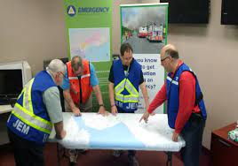
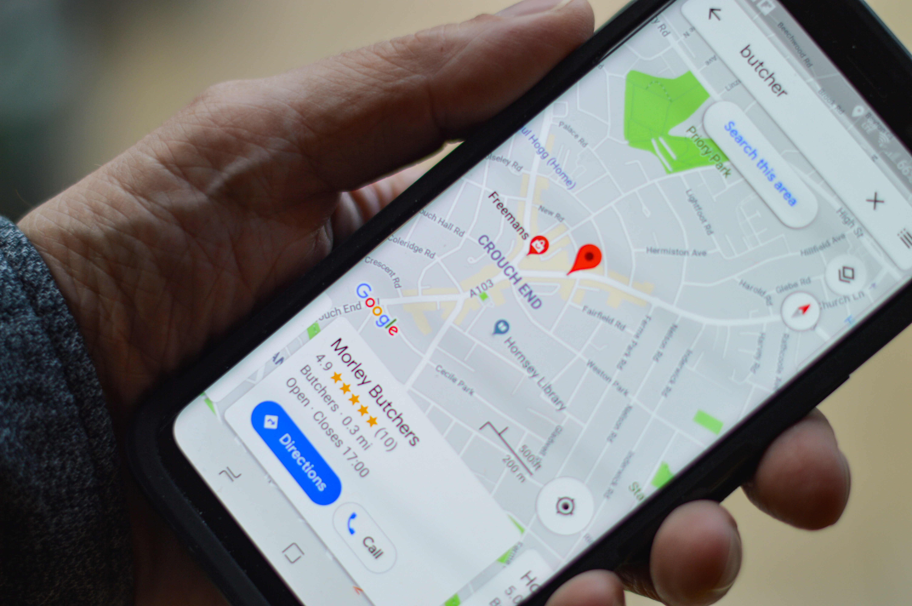

Five Pieces of a Comfort Centre
Psychosocial
Logistics
Management
Location
Personnel
Notes:
Location
HRM owned facilities when available
Personnel
Trained/aware in Comfort Centre mechanics
Management
Comfort Centres will have HRM trained volunteers in key roles
Comfort Centre Manager level two training
Logistics
Materials used in the running of the Comfort Centre – Comfort Centre Kits
Should come from local sources when-ever possible
EM will support when local sources are not available
Psychosocial
When identified, Red Cross is notified to investigate and act
HRM may be able to provide supports and resources through relationships with trained professionals

Slide 15
Opening a Comfort Centre
WHO?
WHEN?
WHERE?
Facility is chosen by EMO with input from JEM
EMO tries to provide latest planning information to affected residents first
Chief Administration Officer (CAO) gives final approval
Emergency Management Office sends request to CAO
JEM may make recommendations to Emergency Management Office
Notification through hfxALERT system and/or Public Service Announcements (PSAs) from HRM
Once approved, JEM volunteers open and operate Comfort Centre
After major event, disruption and/or to support first responders
Once approved and location is confirmed, EMO calls on JEM Duty Officer to activate
Depending on need or the size of the event
Based on needs of the situation, location, and amenities of the facility
Residents register and come back to get information
EMO will make decision to deactivate, with input from JEM management
HOW?
Typically, HRM-owned
Notes:
We covered what a Comfort Centre is in earlier slides. Now let’s go through the who, when, where, and how.
*Information Centre is used more for short term events (1-4 hours) i.e. Old Grand Desert target range ordinance (explosives) disposal

Slide 16

Roles and Responsibilities
Comfort Centre Manager (CCM)
Support Staff Supervisor (SSS)
Responsible for all hospitality issues
Answerable to CCM
Volunteer
Oversight of Comfort Centre
Primary on-site representative
Creates schedule for all personnel working the hospitality area
Assistant
CCM & SSS may appoint assistants to help them in their role
2nd in command to CCM or the SSS
Spontaneous volunteers cannot be used due to insurance and liability issues
Works directly with CCM to coordinate Comfort Centre requirements such as rood replacement, personnel shortages
Registered volunteer – Application, Criminal Background Check, Vulnerable Sector Search required
Set up and operate centre, as directed by CMM & SSS
Reports directly to Duty Officer who is the main contact between the Comfort Centre and EMO
Notes:
Volunteers in any capacity must be registered with HRM and have conducted a clear Criminal Background Check and Vulnerable Sector Search. Spontaneous volunteers are not accepted due to liability.

Slide 17



Expectations for Volunteer Staff
Accountability - sign-in/out
Professional appearance
Keep centre tidy
Follow instruction from leads
Safe food handling
Maintain confidentiality
Welcoming, positive, comforting, supportive of everyone
Notes:
Accountability - sign-in/out
Professional appearance
Keep centre tidy
Follow instruction from leads
Safe food handling
Main confidentiality
Welcoming, positive, comforting, supportive of everyone

Slide 18
Expectations of Elected Officials
Welcome/encouraged to visit Comfort Centres
Report to the Comfort Centre Manager upon arrival
Do not override Comfort Centre Manager’s authority
Offer their assistance when able and when requested to do so
Notes:
Welcome/encouraged to visit:
Councillors have tremendous knowledge of local area and concerns
Can be a great source of information to the CCM and residents
Report to CCM:
Elected officials are instructed to report in with the CCM when arriving
as a courtesy
so that the CCM is aware that they are on site
Do not override CCM’s authority:
The CCM works for EMO and is part of an emergency operation
The Comfort Centre is part of the overall operation of the event
The elected official is not considered operational in an emergency
Offer assistance:
The Councillor should be encouraged to offer whatever they can do to help
It must flow through the CCM to ensure that whatever they are doing compliments the overall operation of the Comfort Centre and does not conflict with overall emergency operational response
Potential of valuable geographical knowledge

Slide 19
Expectations of Emergency Management
Point of contact:
EMO is responsible for the coordination of emergency support during an event, including Comfort Centre management
Public Information:
All media requests must be vetted though EMO
EMO will deliver a public service announcement re: opening, location, hours of operation
Situation Reports:
EMO will schedule regular information sessions with Comfort Centre Manager
Challenge Resolution:
Comfort Centre staff will be provided with training and resources to resolve local issues whenever possible
Purchases and access to HRM resources (e.g. snow removal) requires formal approval
Requests are to be sent to EMO via JEM Duty Officer
Information flows directly between Comfort Centres and EMO
CC Volunteer -> CC Manager -> JEM Duty Officer -> EMO

Slide 20
Comfort Centre Operations
Registration
Paperwork/forms
Supply line and administration

Slide 21

Registration
Volunteer Staff
  All personnel sign-in upon arrival
  All personnel sign-out before leaving
Clients
  All clients to register
  All clients to check out before leaving
Notes:
Comfort Centre Manager (CCM) is responsible for ensuring everyone at the Comfort Center is properly recorded for safety and accountability reasons. If the Comfort Centre had to be evacuated, we need to account for all the people that were present in the building.
All personnel will register with the EM form before entering a Comfort Centre and sign in when arriving at Comfort Centre.
If the registration point is not functioning at the time of entrance, then the SSS will make note of personnel and provide it to the CCM
All personnel will sign out at the time of leaving the Comfort Centre
All clients will register or will not be allowed into the Comfort Centre
All clients will check out when leaving the Comfort Centre

Slide 22

Comfort Centre
Set menu for 48 hours
Document management and control
  All documentation is forwarded to CC Manager (e.g. invoices, receipts, logs and, forms)
  CC Manager will send to designated JEM team lead
A startup kit will be made available to JEM teams
Other supplies may be available for use at the facility. Tracking is required for reimbursement/replacement
HRM EMO will be responsible for securing support when the CC Manager identifies a short fall in the local supply network
Local suppliers should be used whenever possible
Notes:
Upon opening and after set up, the CCM and the Support Staff Supervisor (SSS) will make up a 2 day menu.
CCM will pass this menu to the JEM Duty Officer for action.
Invoices should be collected and submitted to the JEM Chair.
JEM Chair will collate these and forward to EMO lead for payment/reimbursement.
* Initial start up kits contain the very basics to get started with.

Slide 23

Set up
Tables Needed
  Reception (near front door)
  Food Serving (as required)
  CCM/Administration
  Patrons
Room Considerations
  Size and shape
  Numbers expected
  Traffic flow
  Potential duration of event
  Services provided
Notes:
Prepare to accommodate:
Pets – must on leash or in kennel. Notify EMO if special arrangements are required.
Service animals
Children (crayons, coloring pages)
Mobility issues
Hypersensitivity/sensory needs (fidget toys, quiet space)
Medical requirements – oxygen tank, Alzheimer's

Slide 24

Needs Awareness
Seniors, children, mobility issues, medical devices or medical issues
Not all needs are evident
Those requiring accommodations may not wish to discuss their needs
Comfort Centre personnel should try to match up needs with existing support in the community
Notes:
Some people may need additional supports
Not all needs are evident
Those requiring accommodations may not wish to discuss their needs
CC personnel should try to match up needs with existing support in the community
Issues that cannot be resolved should be brought to EMO for a solution
May still be resolved locally at the JEM level
May need to be addressed by EMO
Support groups may be available, can be coordinated via:
EMO
Support agency directly

Slide 25
99% of the time communication will follow normal methods:
When conditions require it, Comfort Centres can use:
Telecommunications
Existing facility telephones
Cell phones, as available
Internet/E-mail/Text
Two-way radios
Amateur Radio
Notes:
Telecommunications are part of the EM/JEM structure
Each rural JEM team in HRM has a facility set up for telecommunications
Telecommunication services may be provided to a Comfort Centre upon request
EMO has access to several types of radios
TMR
VHF - radios are completely independent of all other systems and are mobile, complete with a mobile repeater on a trailer
Amateur Radio (UHF, VHF, HF, Winlink, etc)

Slide 26
Information Flow
EMO
JEM Duty Officers
Comfort Centre Managers
JEM Volunteers
Citizens
Notes:
JEM volunteers are the conduit for all information to and from EMO.

Slide 27
Deactivation
The Comfort Centre can be deactivated when:
  Comfort Centre Manager sends recommendation to EMO for decision
  EMO notifies Comfort Centre Manager of closure
Notes:
The Comfort Centre Manager (CCM) reports to the JEM Team Duty Officer (JDO) who reports to the Liaison Officer of the Emergency Operations Centre (Emergency Management) and vice/versa for communication.
EMO can order the deactivation and closure of the Comfort Centre. Will be done in consultation with the Comfort Centre Manager.
Example: the weather cleared, power is back on so there may be a message that the Comfort Centre will close at a certain day/time.
This firsthand account of communication during Hurricane Dorian, can be shared - CCM passed the info to EM Liaison Officer that we had no clients for an hour, Duty Officer passed it to EMO lead who escalated it to the proper leadership to make the decision. The same chain was used to relay approval and further information to CCM and the Team.

Slide 28
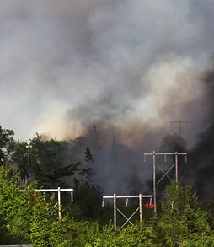
Forest Fire Exercise
Notes:
This can be conducted in several ways:
Group discussion as a whole
Individual groups discuss and present
Notes:
This exercise is not meant to manage a Comfort Centre but to demonstrate the general knowledge of what a Comfort Centre is, propose, basic requirements and operation.
The management and operational logistics are part of the Comfort Centre Level 2 course.
Photo: https://novascotia.ca/natr/forestprotection/wildfire/media-guide/

Slide 29
Purpose
To demonstrate a general understanding of what a Comfort Centre is and general requirements and process to getting one setup and operational.

Slide 30
Opening Comfort Centre in HRM Facility
200 homes with 450 citizens evacuated
Anticipated Centre to be open for 2 days
Today is a Friday 10:00
Mid July
Weather 30C, light winds, Humidity 80% and no rain in forecast for next 5 days
No power outages
Good evacuation routes
Notes:
Scenario

Slide 31
DISCUSSION
What are the things you need to do?

Slide 32
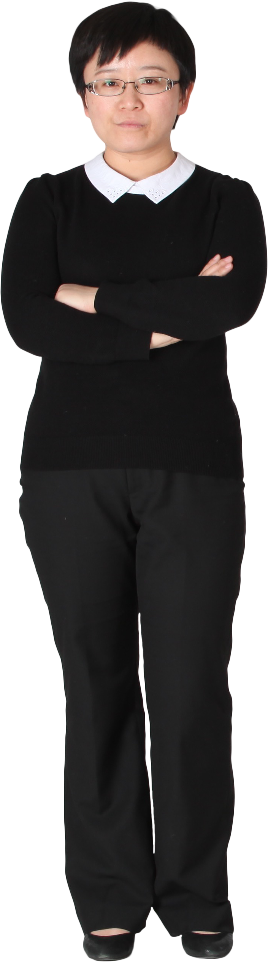
Conflict Resolution Exercise
Notes:
Examples:
Someone arrives at the centre intoxicated. They become upset with the greeter because they don’t want to sign-in and provide contact information. How would you handle this situation?
Two clients have a disagreement, and it starts escalating and you are concerned it will become physical. What do you do?
Try to de-escalate without getting in harms way
Give space and ensure others are not in harms way
Notify CCM
Call police, if necessary
Consider a time that you were upset, what approach helped turn the situation around?

Slide 33
Conflict Resolution
  Attempt to diffuse, de-escalate
    Direct action - resolve the concern
    Distract – change conversation
    Delay – give time calm down to and come back to the situation
    Delegate – bring feedback to management
  Request support from CCM
  Contact lead at EMO for guidance
  Call 911 if necessary
  Safety first!
Notes:
Best practices to remember when dealing with conflict:
Don’t take it personally
Stay calm
Respond to issues, not feelings
Practice empathy – try to understand where they are coming from
Avoid power struggles
Thank for feedback and apologize, as necessary
Be aware of non-verbal responses – stance, posture, tone
Set boundaries & communicate them appropriately
Keep an open mind to other opinions and perspectives
If there is no resolution, walk away or end the conversation appropriately

Slide 34

Zero Tolerance
HRM has zero tolerance for behavior that is illegal, inappropriate, or contrary to code of conduct
Verbal or physical abuse, discrimination, racism, sexualized behaviour
Applies to volunteers, staff, clients
Notes:
HRM has zero tolerance for behavior that is illegal, inappropriate, or contrary to code of conduct
Verbal or physical abuse, discrimination, racism, sexualized behaviour
Applies to volunteers, staff, clients

Slide 35

Volunteers
What do volunteers bring to the table?
  Varied backgrounds bring a wealth of expertise
  Ongoing training is good for the organization and the volunteer
Other courses volunteers can participate in:
  Food Handling
  Comfort Centre Level 2
  Basic Emergency Management
  Incident Command 100
  Radio Communications
  Mental Health
Notes:
Ongoing training is good for the organization and the volunteer
Some of the EM sponsored training can be applied in other parts of the volunteer’s life
Skill sets of volunteers (e.g: American Sign Language, languages, etc.)
Photo by Dakota Corbin on Unsplash

Slide 36
QUESTIONS?

Slide 37
THANK YOU

